Slide 1


Entrepreneurial Competency in University Students
Abdelaziz MTIMET - Paul MELIN - Sandrine PREVOT
January 3th 2022

Slide 2
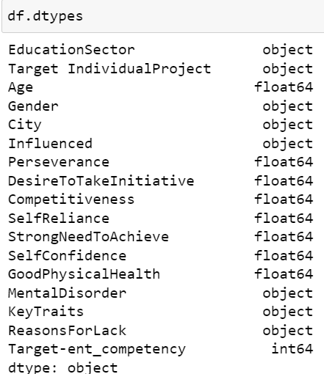
Dataset Description
EducationSector : The different types
Target IndividualProject : Yes /No answers
Age : the age of Students
Gender : Male / female
City : Yes/No (the importance of city )
Influenced : Yes/No answers
Perseverance : integer Type / from 1 to 5.
DesireToTakeInitiative : integer Type / from 1 to 5.
Competitiveness : integer Type / from 1 to 5.
SelfReliance : integer Type / from 1 to 5.
StrongNeedToAchieve : integer Type / from 1 to 5.
SelfConfidence : integer Type / from 1 to 5.
GoodPhysicalHealth : integer Type / from 1 to 5.
MentalDisorder object KeyTraits : Yes /No answers
KeyTraits : the key of succes
ReasonsForLack : this column will be deleted
Target-ent_competency : 0/1 answers

Slide 3
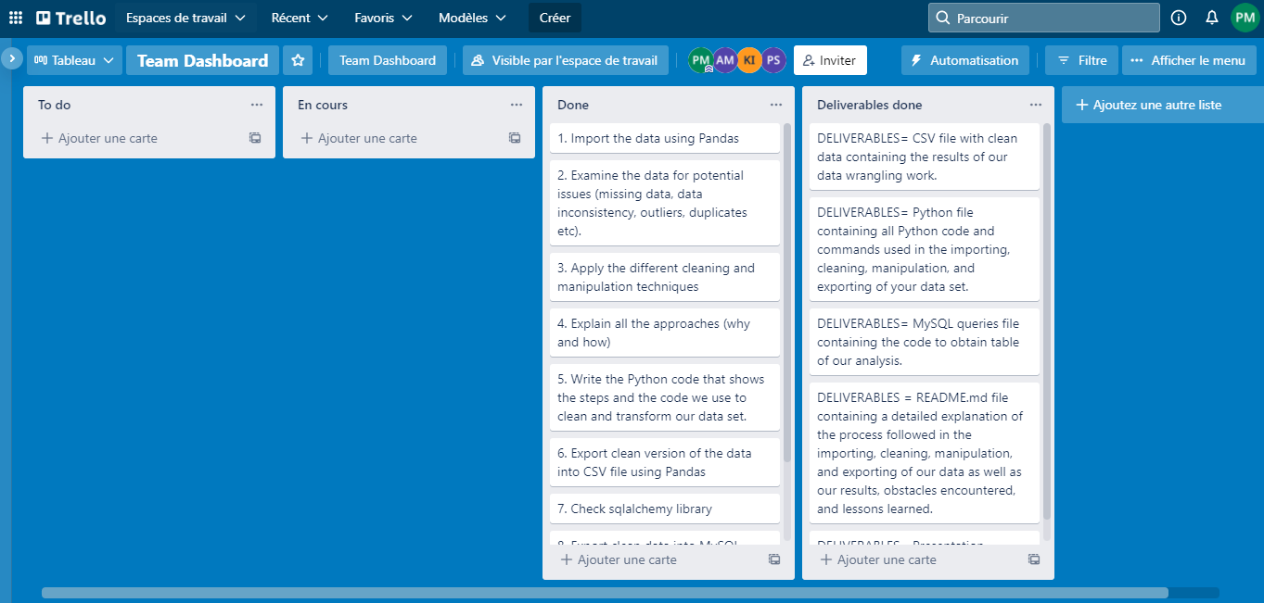
Challenges
understand the main idea of the project
To be able to split the work and share idea via Zoom / Trello and vacation time
Deliver a clean Dataset with Mysql tables
Lien trello :
https://trello.com/b/YMkIJAV3/team-dashboard

Slide 4
Highlights
Take time to check the Dataset (missing value, NaNValue, column to delete…)
Sharing idea and thinking via Zoom
Build a python script to clean Dataset and Mysql tables
Use the Python library (matplotlib, Seaborn) to have some Data visualisation
Discuss the subject issue during vacation

Slide 5
Cleaning Process
## checking missing datas
df.isnull().sum()
Cleaning:
## column « reasonsForlack » have 50% missing value: we decide to drop
Because low correlation
+ no useful data to operate (commentary)
df = df.drop('ReasonsForLack', 1)
## some rows have missing value on many columns: we droping the rows
df.drop(df.index[200:206], axis=0, inplace=True)
## For other: we replaced empty rows with mode of each columns ()
age_mode = df.mode()['Age'][0]
df['Age'].fillna(age_mode, inplace=True)

Slide 6
Cleaning Process
## column: KeyTraits: error in value -
## get unique value, to check the value
df['KeyTraits'].unique()
## replace error-value in Keytraits
df["KeyTraits"].replace("Rrresilience", "Resilience", inplace=True )
df["KeyTraits"].replace("passion", "Passion", inplace=True )
## Uniformize data in column gender and City
df['Gender'] = df['Gender'].str.capitalize()
df['City'] = df['City'].str.capitalize()
## delete all spaces in title columns
df.columns = df.columns.str.replace(' ', ‘’)
:NB we had any duplicate number, neither outliers
df[df.duplicated(keep=False)]

Slide 7
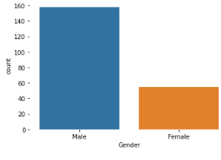
Visuals representation - Gender
Count plot

Slide 8
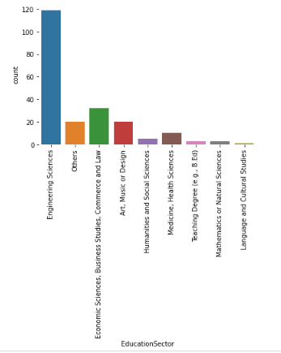
Visuals representation -Educational sector
Count plot

Slide 9
Connexion To SQL
import pandas as pd
import mysql.connector import sqlalchemy
database_username = ‘root' database_password = ‘XXX' database_ip = '127.0.0.1' database_name = 'project3’
database_connection = sqlalchemy.create_engine('mysql+mysqlconnector://{0}:{1}@{2}/{3}'. format(database_username, database_password, database_ip, database_name), pool_recycle=1, pool_timeout=57600).connect()
df.to_sql(con=database_connection, name='df’, if_exists='append’, chunksize=220)
database_connection.close()

Slide 10
Connexion Problem with SQL
(mysql.connector.errors.NotSupportedError)
Authentication plugin 'caching_sha2_password' is not supported
Solution : https://www.youtube.com/watch?v=Ygis_0DKKMg
[SOLVED] Authentication plugin 'caching_sha2_password' is not supported || MySQL Python connector

Slide 11
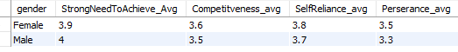
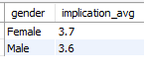
SQL - QUERIES
first query: which gender have more Strong Need to Achieve, Competitiveness, SelfReliance and perserance?
Second query: which gender have more implication?
( implication = StrongNeedToAchieve_Avg + Competitveness_avg + SelfReliance_avg + Perserance_avg)/4
➔ Female perform a little better than male

Slide 12
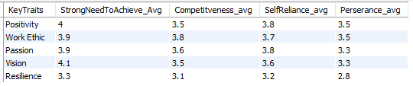
SQL - QUERIES
Third query: which keystraits seems have less Strong Need to Achieve, Competitiveness, SelfReliance and perserance?
➔ Resilience keysTraits have less StrongNeedToAChieve, Competitiveness, SelfReliance and perseverance

Slide 13
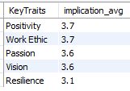
SQL - QUERIES
Fourth: which keystraits have more implication?
( implication = StrongNeedToAchieve_Avg + Competitveness_avg + SelfReliance_avg + Perserance_avg)/4)
➔ Positivity and Work Ethic have more implication

Slide 14
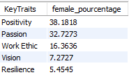
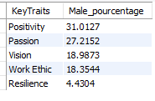
SQL - QUERIES
Fifth query: which KeysTraits by gender (in pourcentage)

Slide 15
QUESTIONS ?

